Slide 1

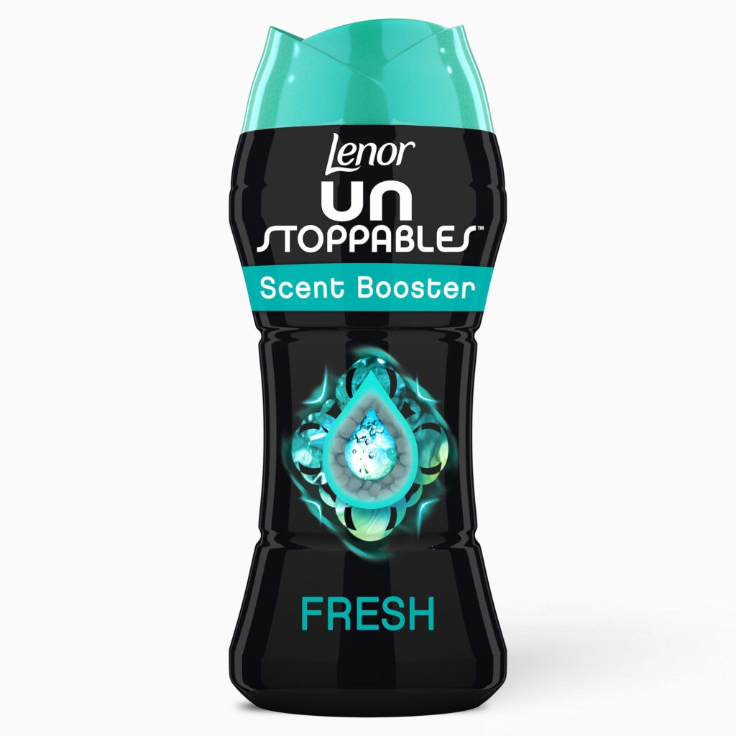

Lenor Unstoppables
Marketing plan
2023-2025
Submitted By -210287787
Candidate no-630498
Course name-Marketing management
Course module-BMM601

Slide 2
Company BRIEF
P&G was founded over 180 years ago as a simple soap and candle company. Today, it is the world’s largest consumer goods company and home to iconic, trusted brands that make life a little bit easier in small but meaningful ways. We’ve spanned three centuries thanks to three simple ideas: leadership, innovation and citizenship.
OBJECTIVE
PRODUCT OVERVIEW
We will provide branded products and services of superior quality and value that improve the lives of the world’s consumers, now and for generations to come. As a result, consumers will reward us with leadership sales, profit and value creation, allowing our people, our shareholders and the communities in which we live and work to prosper.
Lenor Unstoppables is an in-wash scent booster that continues to work even after the current freshness wears off, giving you up to 12 weeks of extended freshness (in storage). Before the wash, the product is added straight into the washing drum. The benefit of the product is long-lasting freshness; it has no cleansing or softening properties.
The product is available in 5 different scent variations and 4 different pack sizes (140g, 210g, 285g, and 570g).
.

Slide 3
PESTLE Analysis
Factors
Description
Threat/ Opportunity
Impact on Business
P Political | E Economical | S Sociological | T Technological | L Legal | E Environmental
Political Unstability after the rapid downfall of lizz truss Prime Minister Liz Truss of Britain has resigned after only 44 days in office. Impacts on British Exports. As the Brexit caused uncertainties in almost every sector of businesses in UK it also brought uncertainty | GDP is anticipated to decrease by 0.4% in 2023 before rising by 0.2% in 2024. Due to rising energy prices, ongoing labour and supply shortages, and other factors, consumer price inflation will reach a peak of almost 10% in late 2022. Thereafter, it will gradually decline to 2.7% by the end of 2024. | The UK has a big consumer market. The current population is over 68.7 million (Worldometer, 2022) The idea of social class has historically had an impact on the UK, despite its Multicultural population. The UK is one of the top 10 nations with the world's highest level of education among its citizens. | One of the nations in the world with the most advanced technology is the UK. London is the world's second-most connected tech hub after Silicon Valley, and 25% of entrepreneurs worldwide say they have important connections with at least two people who are headquartered there. | The rights of employees are supported by the Employment Act of 1996. Companies are required by this law to uphold and respect employee rights. The Equality Act of 2010 defends and protects people from being labelled based on their race, gender, or other differences. | The UK Government is organising a series of conversation sessions in collaboration with the Ocean Plastics Leadership Network, a group made up of representatives from industry, scientists and activists. These events are essential to bolstering the UK's prominent position during the treaty negotiations.
Threat | Threat/Opportunity | Opportunity | Opportunity | Opportunity | Opportunity
High | High | Low | High | Low | High

Slide 4
Competitor Analysis | Lenor Unstoppable | Fairy Fresh | Air wick Woolite | Airpure Incrediballs | Swirl Scent booster | Ocado
Company | P&G | P&G | Reckitt | Airpure | Swirl | Ocado
Website | https://www.pg.co.uk | https://www.pg.co.uk | https://www.reckitt.com | https://airpure.com | https://www.swirl.com | https://www.ocado.com
No of Employees | 106000 | 106000 | 43000 | 10-50 | 10-50 | 19000
Headquater | Cincinnati, Ohio | Cincinnati, Ohio | Slough, England, | Bury,UK | China | Hatfield, Hertfordshire
Product benefits | It offers up to 12 weeks of extended freshness (in storage), ensuring that your clothing retain their freshness and favourite aroma for a longer period of time. | In-wash aroma booster, dermatologically approved, for moderate freshness that endures. Fresh cardboard from Fairy Beads with no dyes | Your favourite Air Wick Scent, enhanced with 30 Essential Oils, will enhance the fragrance of each wash. Discover a lingering scent for the fabrics you and your family will be using. | With the help of this Scent booster, you may revitalise your entire wardrobe. The scent generated during the washing process is contained in each individual pearl. cruelty-free and vegan | Extremely easy to use, simply add this to your washing for fragrance boost on your clothing and other fabrics. | Boosts and enhances fragrance Keeps your laundry fresher for longer Not tested on animals.
Price | 14£ per kg | 15£ Per Kg | 12£ per Litre | 9£ per Kg | 7£ per Kg | 10.7£ per Kg
Threats | N/A | High | High | Moderate | Low | Low

Slide 5
Swot Analysis
Strength Over time, a strong brand equity was built ,the flagship brand P&G . Widespread distribution system Dominance in the Scent booster market (mid priced segment). Offering high quality and premium eco-friendly product | Weakness Various lower priced products available in the market Strong competitors Competetion within own brand P&G through Fairy fresh and Downy.
Opportunity Export to developing or adjacent nations Expand market share in the premium category through the introduction of variants Selling a product or service to a specialized segment of a market. | Threats The sector of Scent booster has low profit margins. Threat from both established and emerging market participants. Government Regulation different over worldwide.
S
W
O
T

Slide 6
Segmentation, Targeting and Positioning Decisions
S
Segmentation
Create profiles for the resulting categories after identifying the market's fundamental variables.
T
Targeting
Evaluation of segment attractiveness
selection of the target portion.
P
Positioning
Application of Positioning
Identification of Positioning Concepts

Slide 7
Market segmentation
Geographical Between 2020 and 2021, the market for laundry scent enhancers is anticipated to expand by 8.7% annually (YoY). With a predicted sales value of roughly US$ 163 million throughout the evaluation period, the U.S. is predicted to dominate the North American market. With a robust CAGR of 7.6% through 2031, the laundry scent boosters market in the U.K. is anticipated to have the largest share in Europe. By the end of the following decade, the Germany market is expected to have contributed a revenue share of more than US$ 42.5 million. | Demographical Working women must set aside time for cleaning and laundry. Fact.MR claims that Europe has the highest percentage of women (49%) who perform all household tasks independently, including cleaning, which has resulted in strong regional market development.

Slide 8
Market Decision- Demographic
www.factmr.com, n.d.2022

Slide 9
Market targetING Decision
Target Strategy
Un-differential
Differential
Concentrated
Customized
Differential Strategy
Diversification of scent boosters for different customers as per their fragrance, clothes fabric, clothes like some customers want different fragrances in clothes as per the occasion.

Slide 10
Market positioning
High brand
Lenor
Unstoppable S2
Repositioning
Lenor
Unstoppable S1
Air wick
Woolite
Fairy Fresh
Low Price
High price
Ocado
Airpure
Incrediballs
Swirl
Low brand
www.factmr.com, n.d.2022

Slide 11
Market POSITIONING
Brand | Current Position Price | Current Position Brand | New Position Price | New Position Brand | Advantages of new position
S1 | Mostly better than opponents | Relatively higher | Normal to opponent | Normal market | Normal in market
S2 | Moderately High than opponents |  | Normal to opponents | Good market | Best in market

Slide 12
Marketing Objective
As per the 2023-2025 plan , Lenor unstopplable should be start his business in south Asian country , specially china and india as 1/3 rd of the population of worls thats in this two country. The growth of Lenor unstopabble should be more than 20 % by sale because as per Fact.MR the With a robust CAGR of 7.6% through 2031, the laundry scent boosters market in the U.K. By 2025 Lenor unstoppable will be the best scent booster in the world as already the product will be launced in other country

Slide 13
As Lenor unstoppable is expanding globally, P&G should concentrate on the South Asian market with research and planning However, planning for the audience entails more than simply determining who would benefit from the products or services most..
Changing of packaging –Instead of plastic Lid some ecofriendly Lid should be used.
Change of name – Removal of Unstoppable from the name as its to lengthy.
Uses of natural fragrance instead of chemical.
The USA and the UK are important markets for scent Booster.
Only separate market teams for the UK and the USA should be established.
Should provide Lenor Unstoppable's sales and marketing staff with some further incentives.
Create competition between the US and UK sales and marketing teams.
Due to competition in market Discount on price if buying more than 2 pieces.
Arrange sales event in which product should sell in cheaper than market.
should use a price penetration strategy when launching new items to capture market share, offering a starting price that is lower than rivals.
Paid social media promotion-Instagram, snapchat,facebook.
Should given complimentary lenor scent booster bottle with other detergent of P&G as Promotion advertisement.
Conducting Campaign in which sample product should be given complementary.
Planning
Product
People
Price
Promotion
Should sell product through Vendor machine by placing Vendor machine in Laundry area in student accommodation, Apartements, Local store.
Attending university fair they can target student .
Collaboration with a brand influencer
Relationship with detergent, soap, and fragrances. Detergent, soap, and perfumes of the same brand should also be produced.
Good product presentation to wholesale suppliers will catch them in. Even company should send gifts to senior wholesaler and supplier.
The sales and marketing teams were knowledgeable about the product and were passionate about it.
Marketers should strive to make customers passionate about their products.
Place
Partner
Presentation
Passion
MARKETING
MIX
9P’s

Slide 14
MARKET Metrics
P&G should perform appropriate public awareness campaigns to make their products known to everyone. Product packaging must be a priority for the sales and marketing teams if they want to improve product sales. Installation of a Lenor Unstoppables Scent Booster vending machine in a dorm room, apartment building, or hotel laundry room. To reach the target audience, P&G must run an advertisement on television, via social media, through offline marketing, etc.

Slide 15
Suggestions
P&G should concentrate on environmentally friendly packaging, especially the lid because a single lid contributes significantly to atmospheric pollution. Plastic is used in even the thin layer that covers the bottle. Lenor's unstoppable indegrient contains chemicals, therefore they can use natural indegrient instead of chemicals to benefit society. P&G should concentrate on branding for Lenor Unstoppables as many people are unaware of the product, which is the primary cause of the product's low sales. Future P&G should concentrate on a product that combines a fragrance booster with a detergent so that everyone can pay attention to it.

Slide 16
rEFERENCES
Anon, (n.d.). Brand Equity – Split Second Research. [online] Available at: https://splitsecondresearch.co.uk/brand-equity/ [Accessed 16 Dec. 2022]. Ashcroft, R.T. and Bevir, M. (2017). Multiculturalism in contemporary Britain: policy, law and theory. Critical Review of International Social and Political Philosophy, [online] 21(1), pp.1–21. doi:10.1080/13698230.2017.1398443. Barbaro, M., Johnson, M.S., Bonja, R., Reid, W., Wood, C., Harper, S., Badejo, A. and Lozano, M. (2022). The Rapid Downfall of Liz Truss. The New York Times. [online] 21 Oct. Available at: https://www.nytimes.com/2022/10/21/podcasts/the-daily/liz-truss-resigns-conservative-party.html. CFI team (2022). Threat of New Entrants. [online] Corporate Finance Institute. Available at: https://corporatefinanceinstitute.com/resources/management/threat-of-new-entrants/. CXL. (2019). 4 Product Pricing Strategies and Techniques. [online] Available at: https://cxl.com/blog/product-pricing-strategies-and-techniques/. Ismail, N. (2018). The biggest tech hubs in the UK — and which is right for your business?|The biggest tech hubs in the UK — and which is right for your business?|The biggest tech hubs in the UK — and which is right for your business? [online] Information Age. Available at: https://www.information-age.com/biggest-tech-hubs-uk-right-business-10575/.‌

Slide 17
References
Matthew Reymes Cole (2020). List of Employment Laws in the UK. [online] Croner. Available at: https://croner.co.uk/resources/employment-law/legislation-list/. OECD (2022). United Kingdom Economic Snapshot - OECD. [online] Oecd.org. Available at: https://www.oecd.org/economy/united-kingdom-economic-snapshot/. ResearchGate. (n.d.). (PDF) Political and Economic Impacts of Brexit on UK. [online] Available at: https://www.researchgate.net/publication/343051163_Political_and_Economic_Impacts_of_Brexit_on_UK. Wordstream.com. (2014). 7 Niche Marketing Ideas for Specialized Businesses. [online] Available at: https://www.wordstream.com/blog/ws/2014/10/28/niche-marketing. World Population Review (2020). Most Educated Countries 2020. [online] worldpopulationreview.com. Available at: https://worldpopulationreview.com/country-rankings/most-educated-countries. Worldometers (2022). U.K. Population (2019) - Worldometers. [online] Worldometers. Available at: https://www.worldometers.info/world-population/uk-population/. ‌‌

Slide 18
REFERENCES
Wright, M. (2020). The Complete Guide to STP Marketing: Segmentation, Targeting & Positioning. [online] Yieldify. Available at: https://www.yieldify.com/blog/stp-marketing-model/. Study.com. (2022). [online] Available at: https://study.com/learn/lesson/target-marketing-strategies-overview-examples.htML‌‌ www.factmr.com. (n.d.). Fact.MR – Laundry Scent Booster Market By Use Case (In-wash & After-wash Laundry Scent Boosters), By Fragrance (Floral Laundry Scent Boosters, Fresh Laundry Scent Boosters, Apple Laundry Scent Boosters, Lavender Laundry Scent Boosters), By Form, By Packaging Type - Forecast 2021-2031. [online] Available at: https://www.factmr.com/report/477/laundry-scent-booster-market. www.pg.co.uk. (n.d.). P&G purpose, values and principles. [online] Available at: https://www.pg.co.uk/policies-and-practices/purpose-values-and-principles/.

